Slide 1
BIO 523 Project
Ameya Kumar 2021447
Anjaneya Sharma 2021449

Slide 2
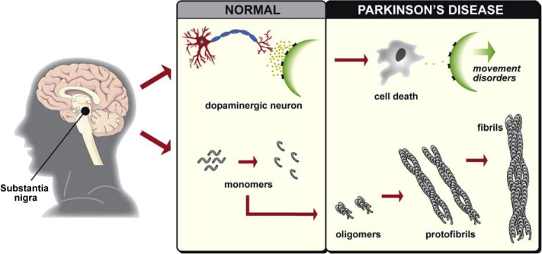
Why did we choose alpha synuclein as our target protein?
Parkinson’s Disease :-
What is it?
A progressive neurodegenerative disorder affecting movement control.
Key Symptoms:
Tremors, rigidity, bradykinesia (slowness of movement), and postural instability.
Cause:
Loss of dopaminergic neurons in the substantia nigra.
Presence of Lewy bodies composed of alpha-synuclein.
Impact:
Affects 10 million people worldwide.
No cure; treatments aim to manage symptoms.

Slide 3
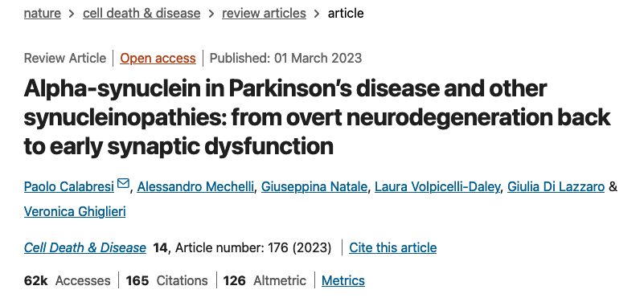
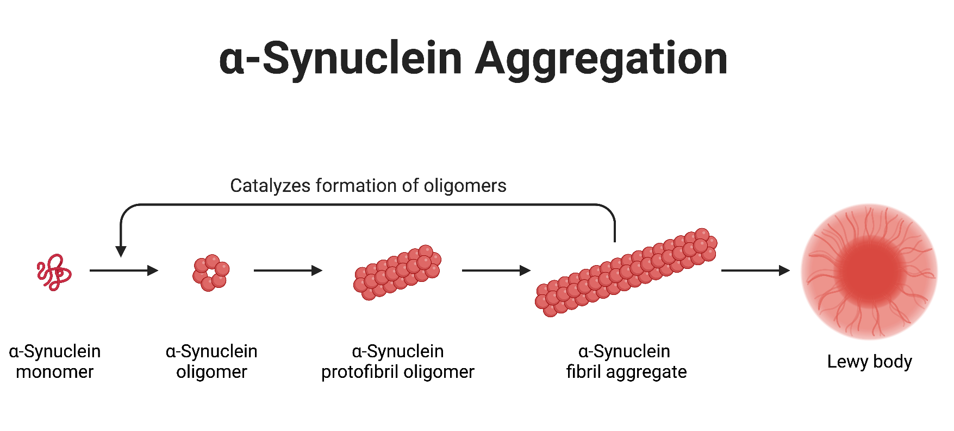
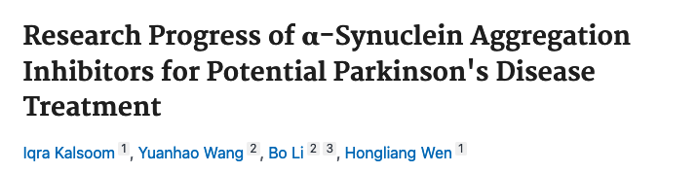
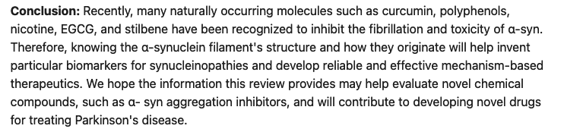
Role of alpha synuclein in Parkinson’s disease

Slide 4
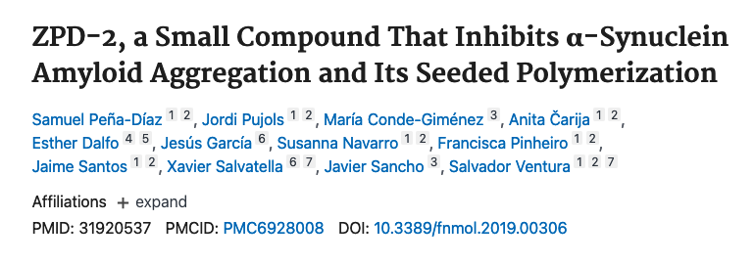
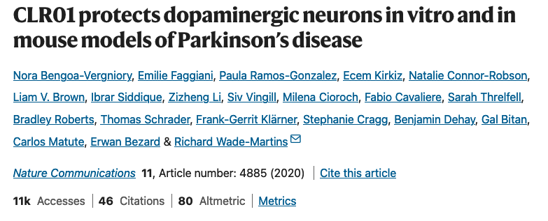
Literature Review
Inhibits aggregation and seeded polymerization:
ZPD-2 interferes with the formation of amyloid fibrils and prevents the propagation of pre-formed aggregates.
It acts at substoichiometric concentrations, demonstrating high potency.
Effective against wild-type and mutant forms:
Specifically targets wild-type α-synuclein and familial Parkinson’s mutants like A30P and H50Q.
Suggests potential efficacy across diverse genetic variants of the disease.
Reduces neuron degeneration (C. elegans model):
In a C. elegans Parkinson's model, ZPD-2 decreased dopaminergic neuron loss.
Improved motility in the worms, indicating functional neuroprotection.
Decreases aggregation and neurotoxicity:
CLR01 disrupts α-synuclein oligomerization by binding to lysine residues.
Reduces the formation of toxic oligomers and fibrils, preventing cell death.
Improves motor defects (mouse model):
Tested in transgenic mouse models overexpressing human α-synuclein.
CLR01 treatment enhanced motor coordination and reduced bradykinesia.
Reduces oligomeric burden:
CLR01 selectively targets oligomeric and fibrillar α-synuclein without affecting monomers.
Significantly lowers soluble oligomer levels in the brain, reducing toxicity.

Slide 5
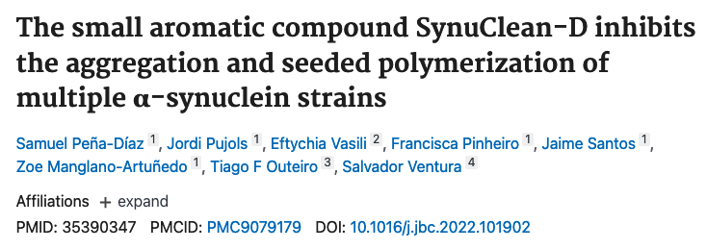
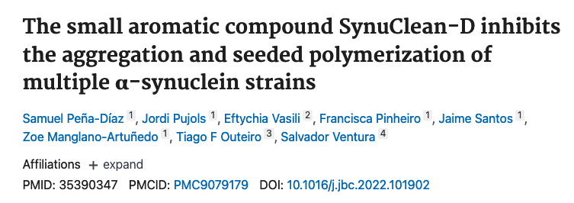
Literature Review
Inhibits aggregation:
Blocks the initial stages of α-synuclein aggregation, preventing fibril and oligomer formation.
Exhibits high efficacy at micromolar concentrations in vitro.
Similar to CLR01 in reducing neurotoxicity:
Reduces the formation of toxic oligomers that disrupt cellular membranes.
Improves viability of cultured neurons exposed to aggregated α-synuclein.
Potential mechanism in aggregation pathways:
Targets hydrophobic regions critical for aggregation.
May also promote the clearance of pre-formed aggregates through cellular mechanisms.
Inhibits aggregation via catechol interactions:
Utilizes catechol groups to interact with key α-synuclein residues, disrupting aggregation.
Works by stabilizing non-toxic conformers of α-synuclein.
Promotes soluble oligomeric intermediates:
Facilitates the formation of soluble, non-amyloidogenic oligomers.
Prevents the transition to toxic fibrils, offering neuroprotection.
Unique mechanism for modulation:
Unlike traditional inhibitors, 03a10 reshapes the aggregation pathway by favoring off-pathway intermediates.
Offers insights into novel therapeutic approaches targeting early aggregation states.

Slide 6
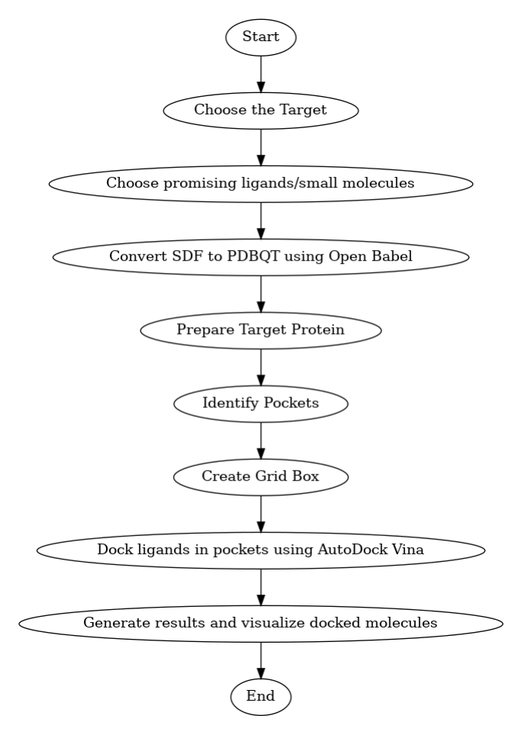
Methodology
Target Selection: Identify a relevant protein/receptor for the study.
Ligand Preparation: Select promising small molecules and convert to PDBQT format for docking.
Protein Preparation: Clean structure, add hydrogens, and assign charges.
Pocket Identification & Grid Creation: Locate binding sites and define grid parameters for docking.
Docking: Use AutoDock Tools to evaluate ligand binding in target pockets.
Analysis & Visualization: Compare docking results and visualize interactions.
MD Simulation (Optional): Validate results by simulating ligand-protein complexes

Slide 7
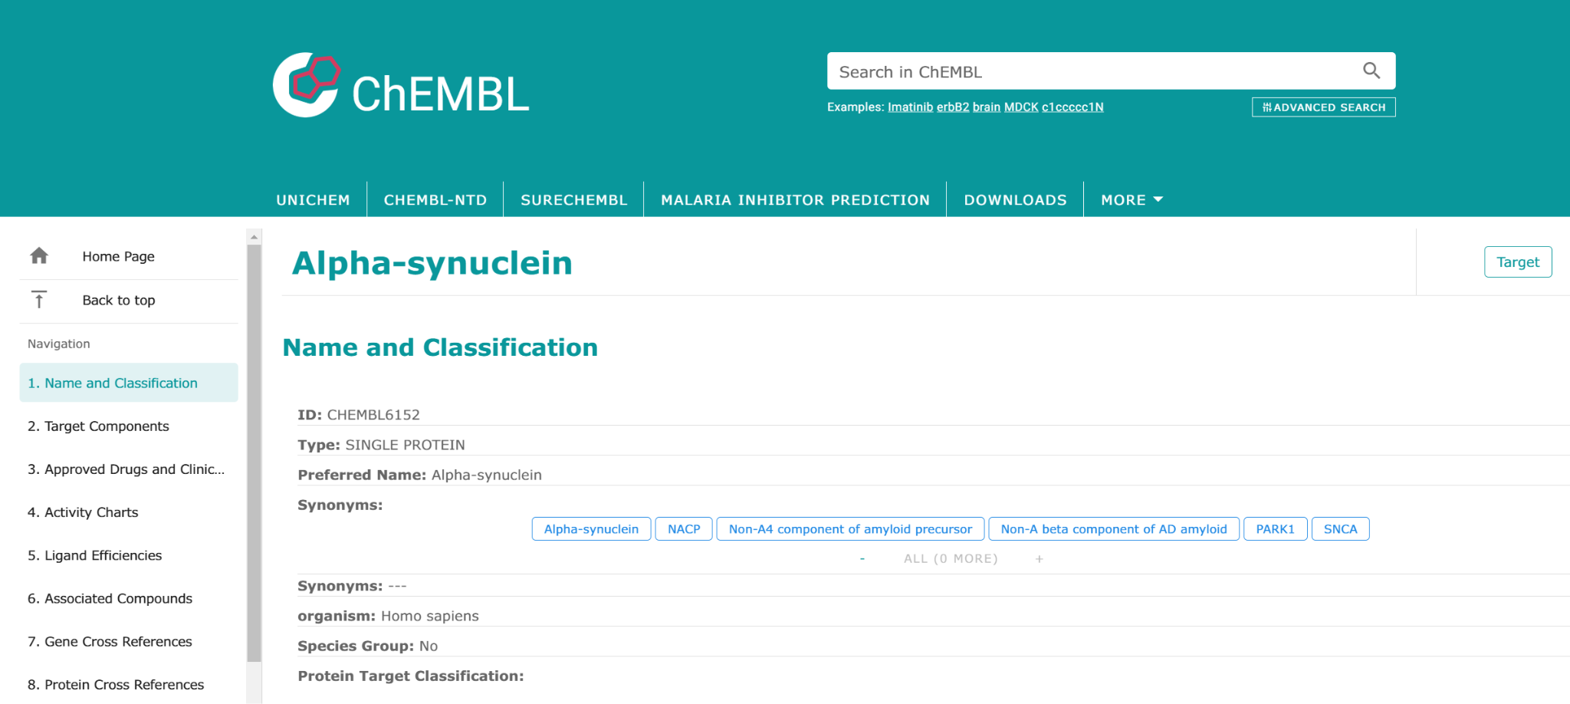
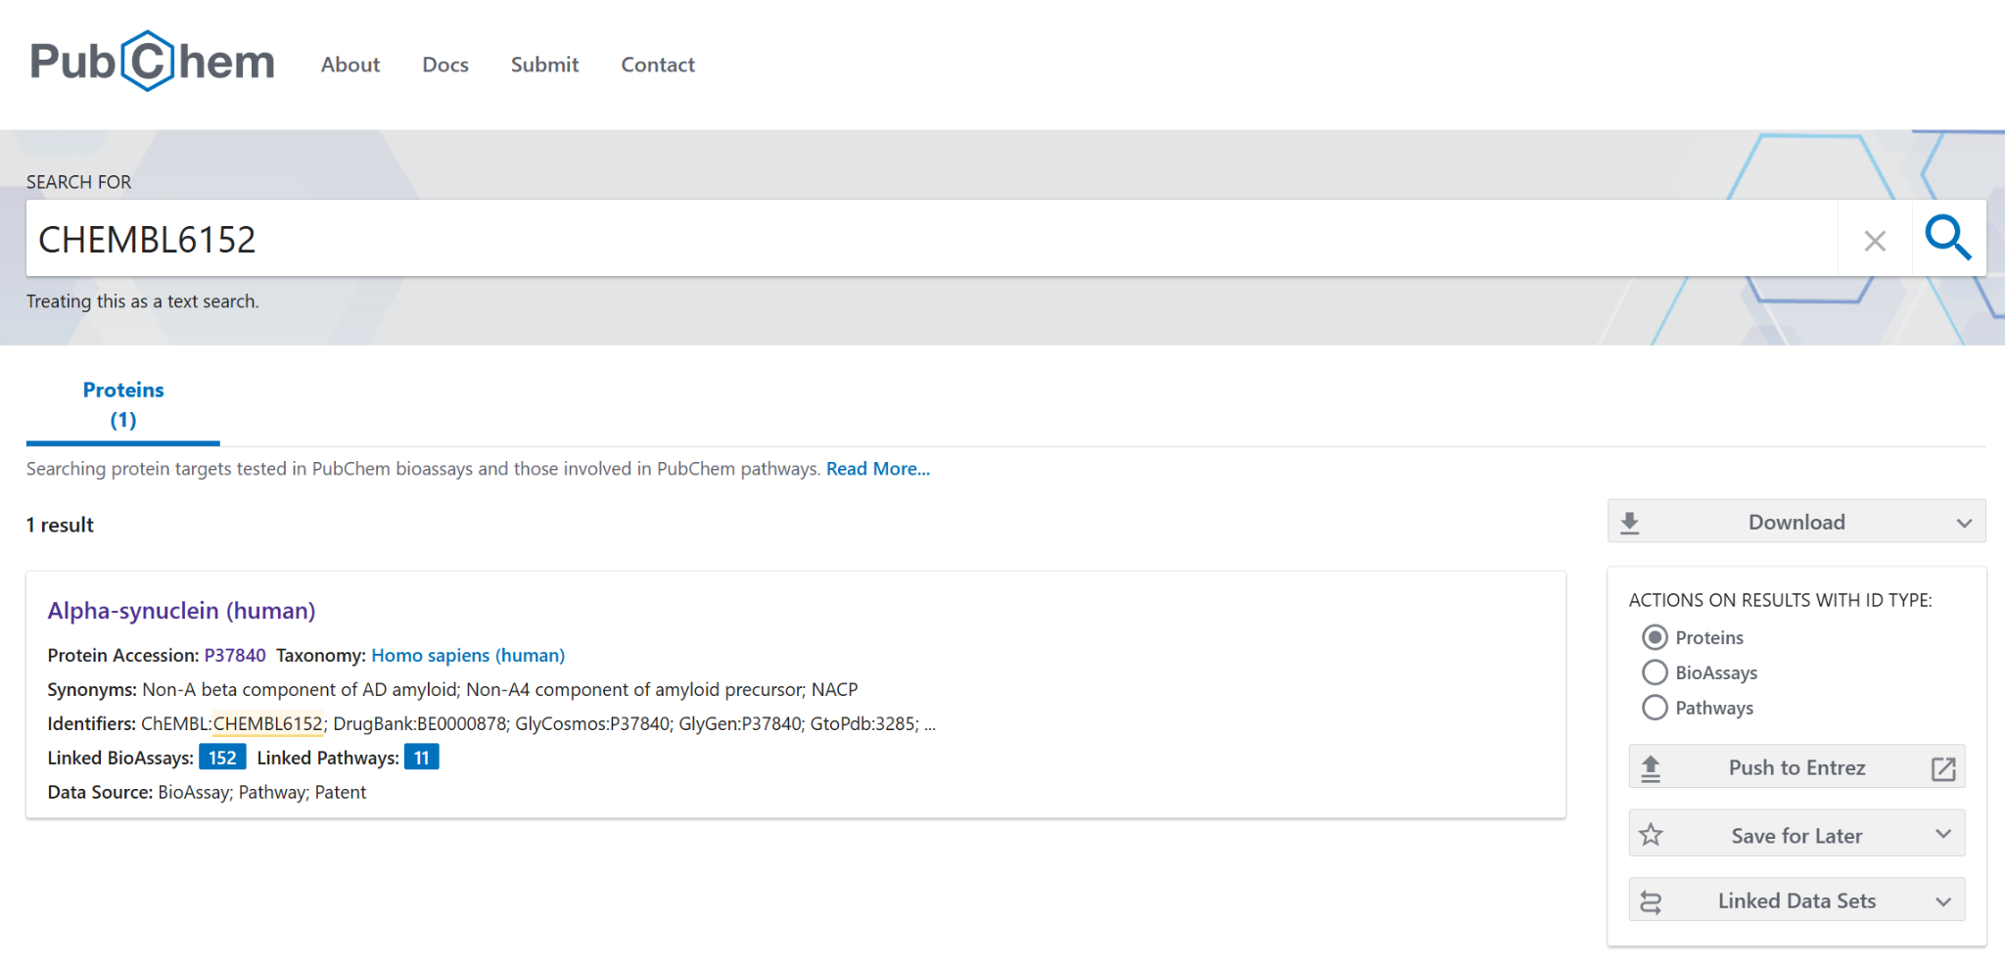

Slide 8
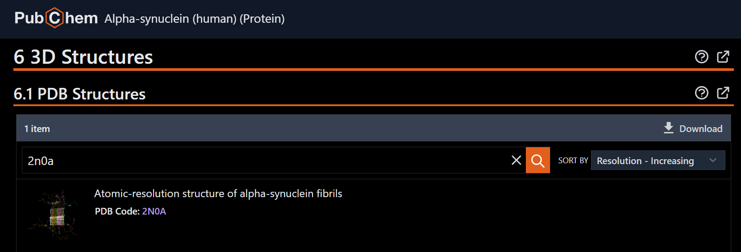
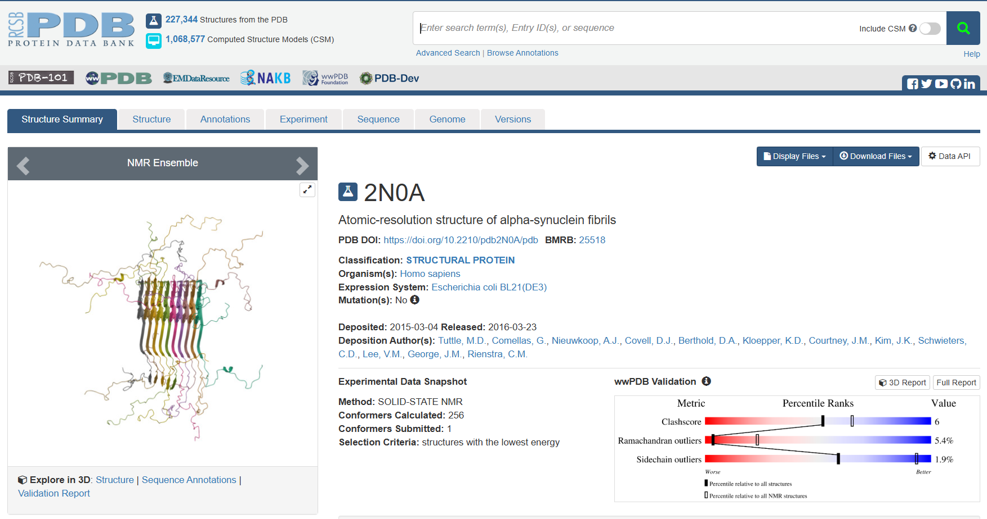

Slide 9
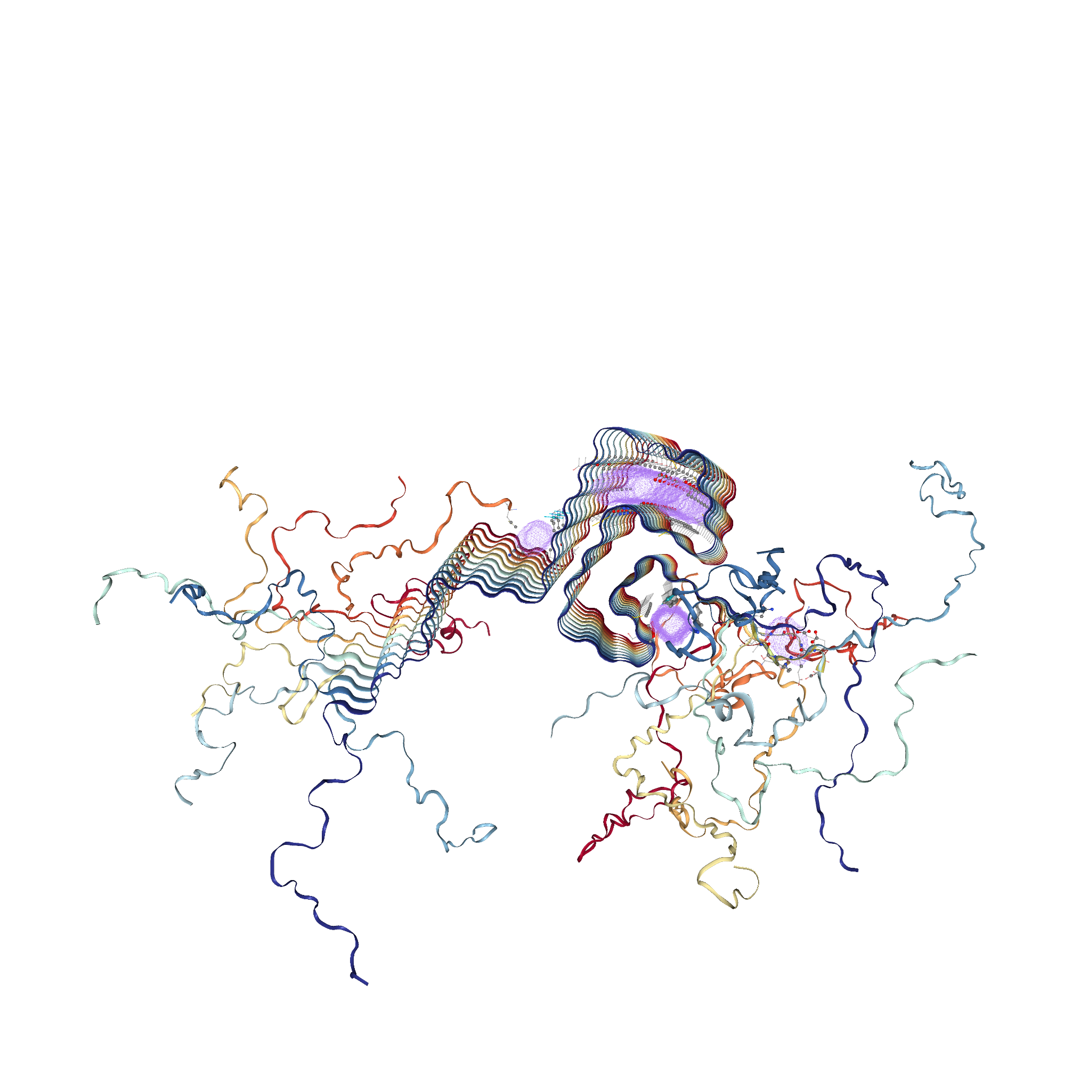
Receptor

Slide 10
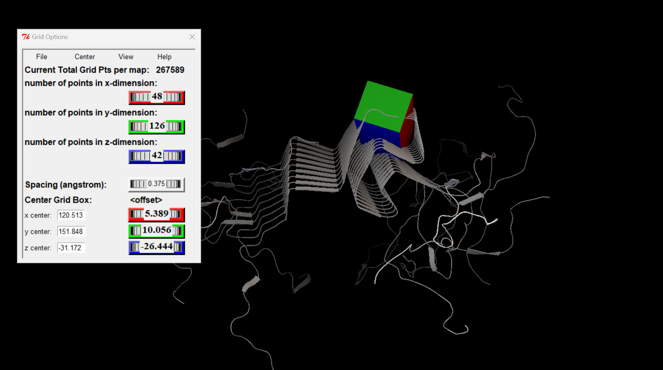
Grid Box
Pocket A

Slide 11
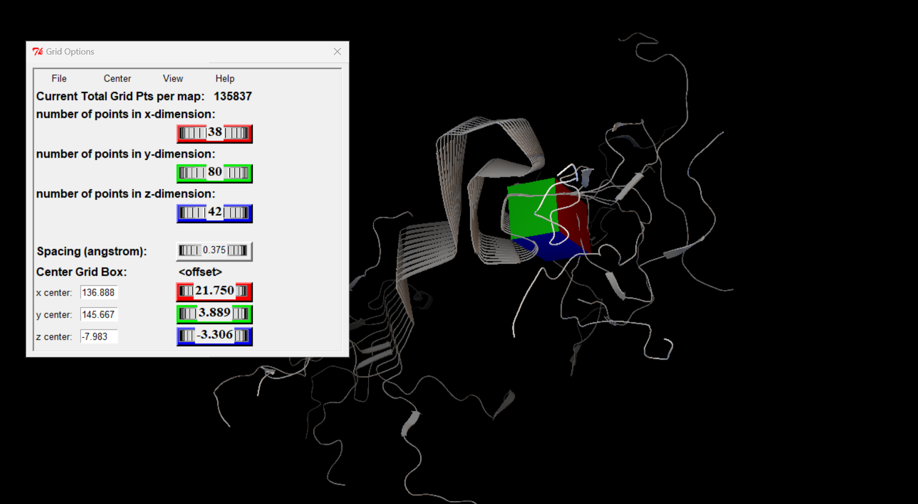
Pocket B

Slide 12
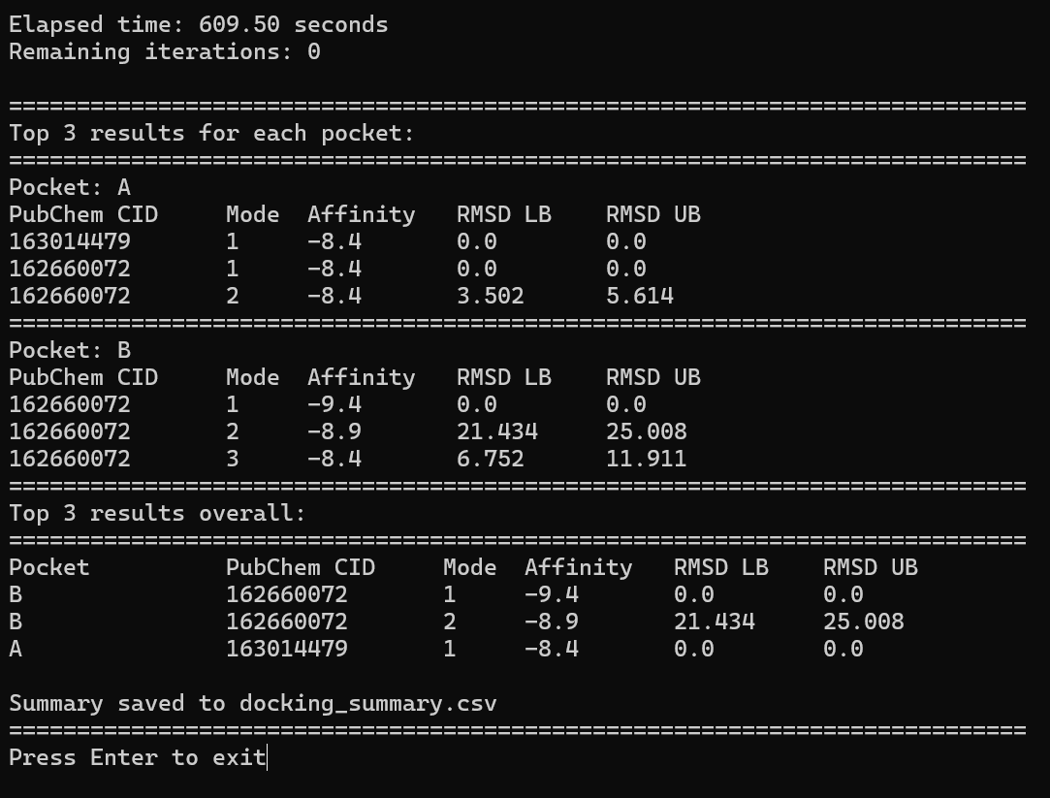
Docking Summary

Slide 13

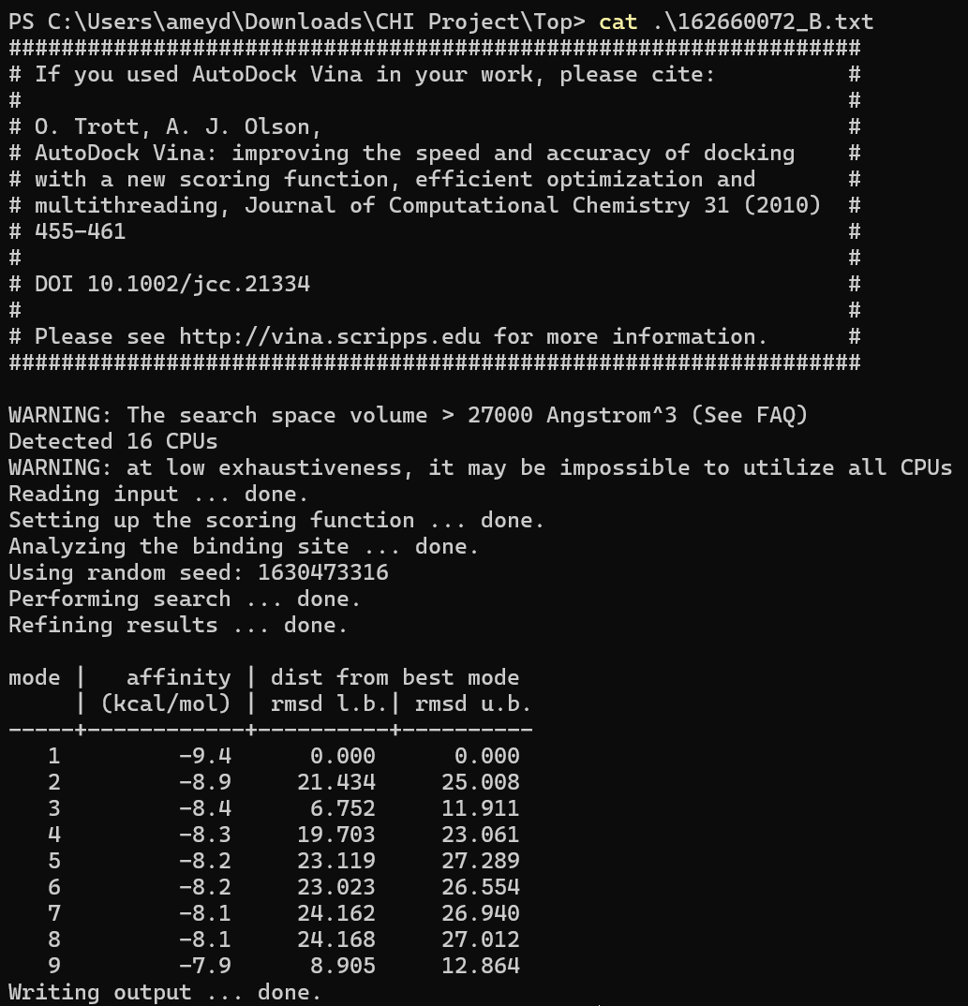
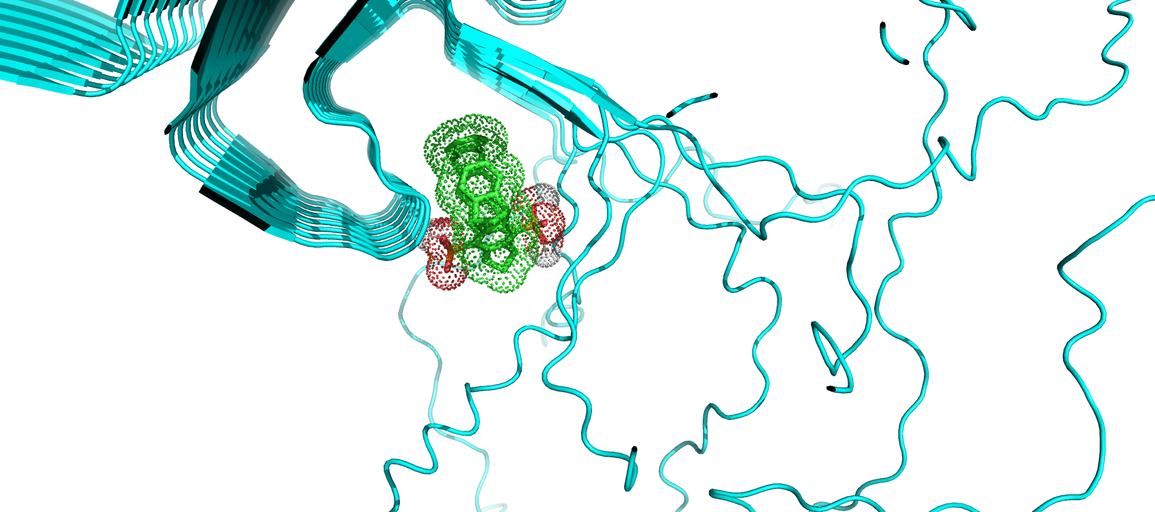
16266072 Pocket B

Slide 14

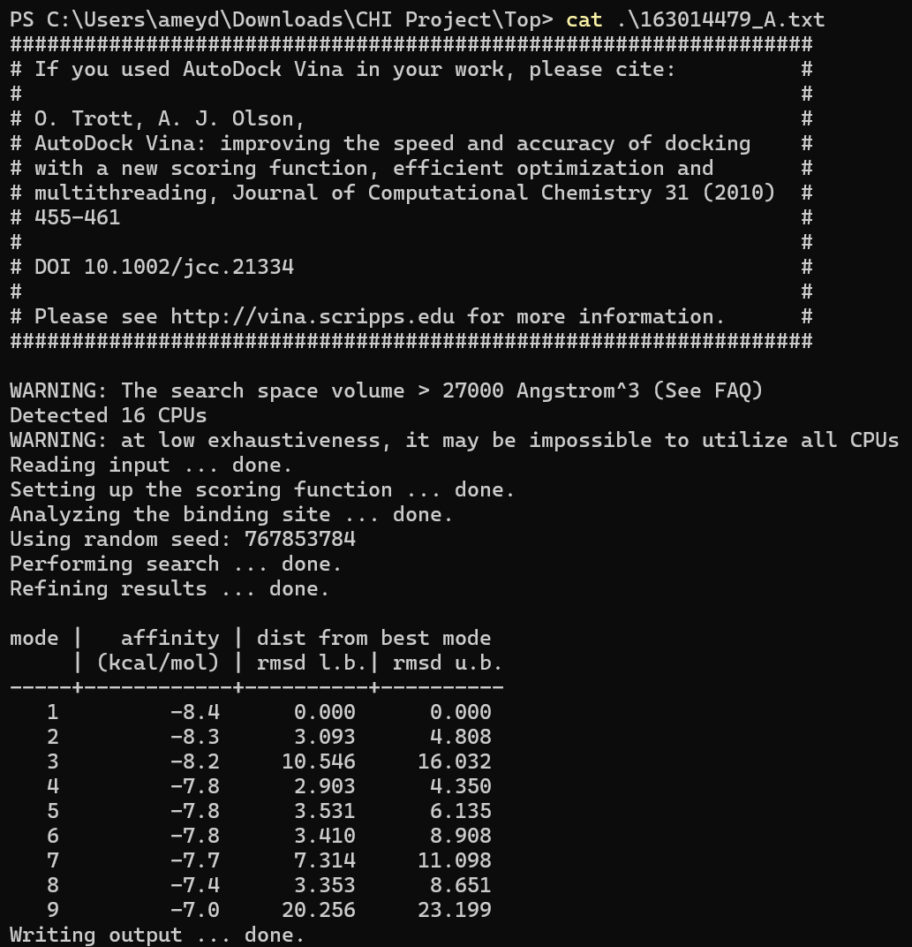
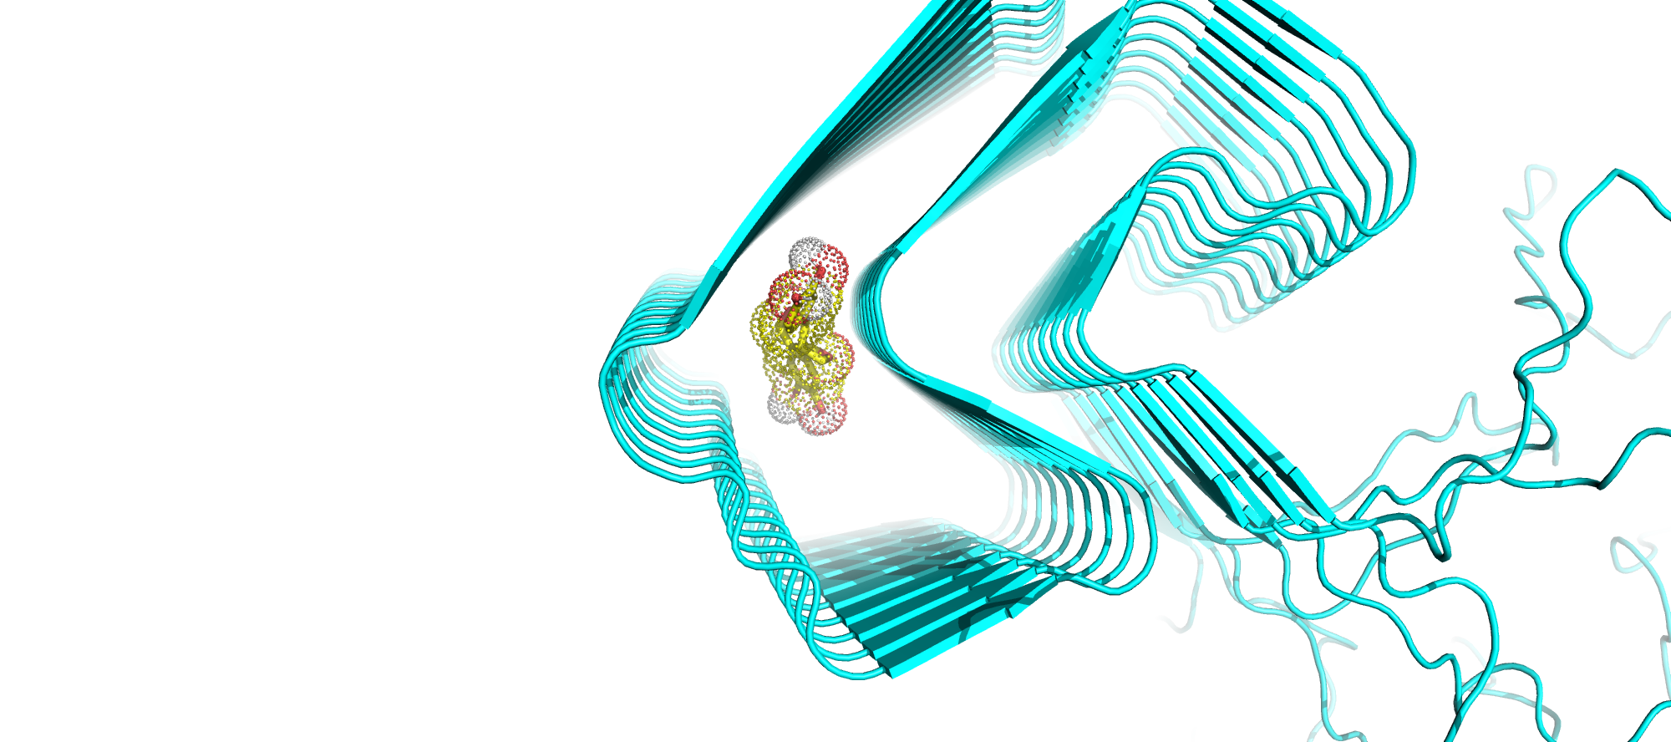
163014479 Pocket A

Slide 15

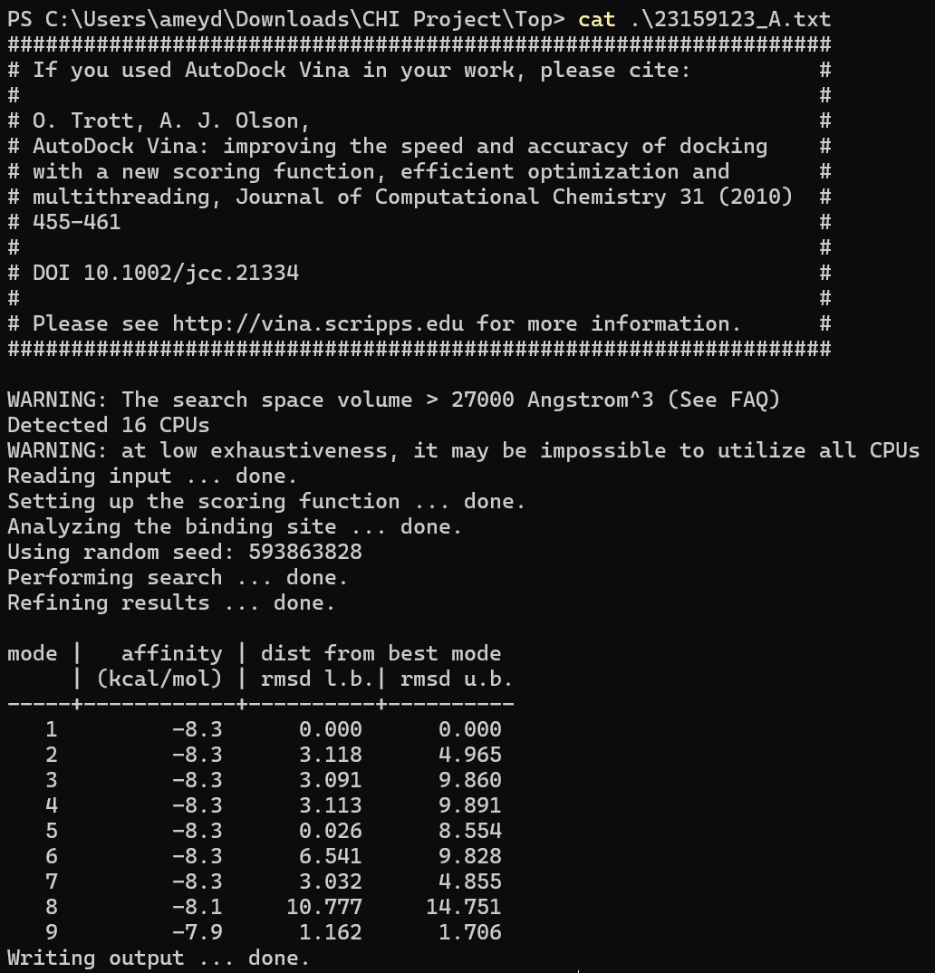
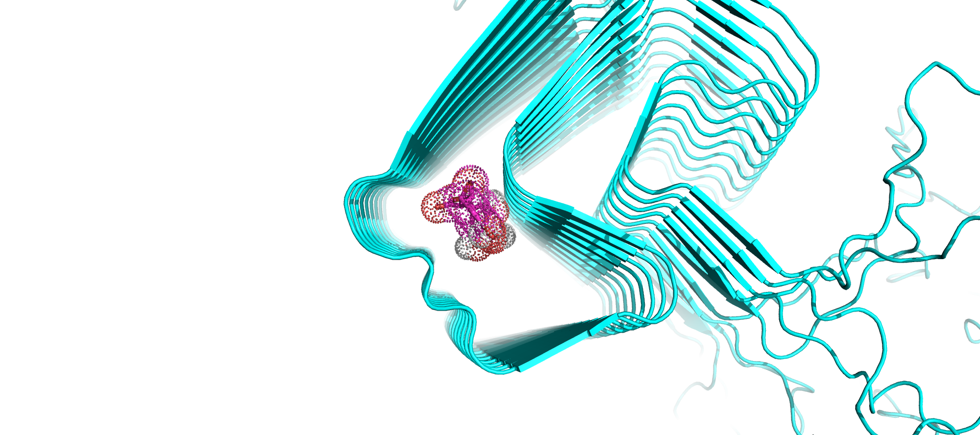
23159123 Pocket A

Slide 16
Demo
https://youtu.be/2avDg9mydoY

Slide 17
Challenges Faced
Incomplete or missing 3D structures from sources like PubChem.
Computationally intensive processing and storage requirements
Accuracy of docking results may vary; scoring functions may not always correlate with real biological affinity.
Receptor flexibility not accounted for in docking models
Failures at various stages (download, conversion, docking) can derail automation
Automated extraction and analysis of docking metrics
Optimizing computational resources and parallelizing tasks for larger datasets
Ensuring consistent and reproducible results across runs

Slide 18
Future scope
1. High-Throughput Docking and Screening
Large-Scale Screening:
Use high-throughput virtual screening with broader compound libraries.
AI Integration:
Incorporate AI/ML for predicting new ligands and prioritizing candidates based on docking and ADMET scores.
2. Combination Therapy
Synergistic Effects:
Test combinations of the screened ligands with existing Parkinson's disease drugs like levodopa or dopamine agonists.
3. Ligand Optimization
Structure-Activity Relationship (SAR):
Optimize the chemical structures of lead compounds to improve binding affinity and specificity.
Pharmacokinetics and Toxicity:
Evaluate ADMET properties (absorption, distribution, metabolism, excretion, and toxicity).

